Slide 1
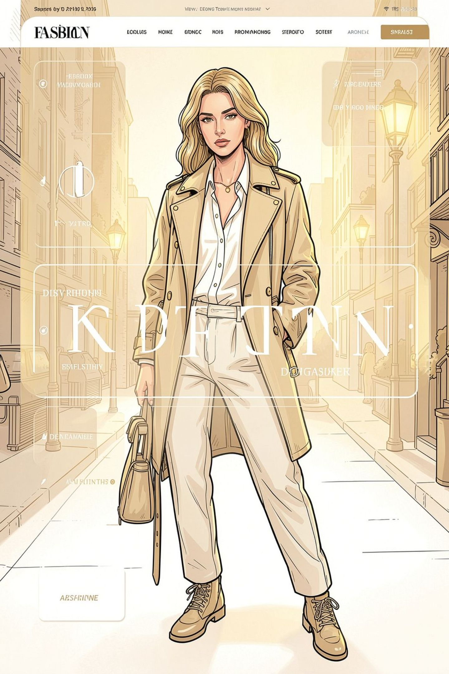

Teju's Wardrobe — Smart Fashion & Outfit Matching
Discover Your Perfect Style — a premium, responsive frontend prototype built with HTML, CSS, and JavaScript that lets users select clothing, preview layered outfits, and save looks with LocalStorage.

Slide 2
Deck Overview
Goal
Tech
Deliverables
Interactive outfit builder with layered preview and smart matching recommendations.
HTML5 • CSS3 (glassmorphism + responsive) • JavaScript • LocalStorage
Complete working source: index.html, style.css, script.js, images/ structure.

Slide 3
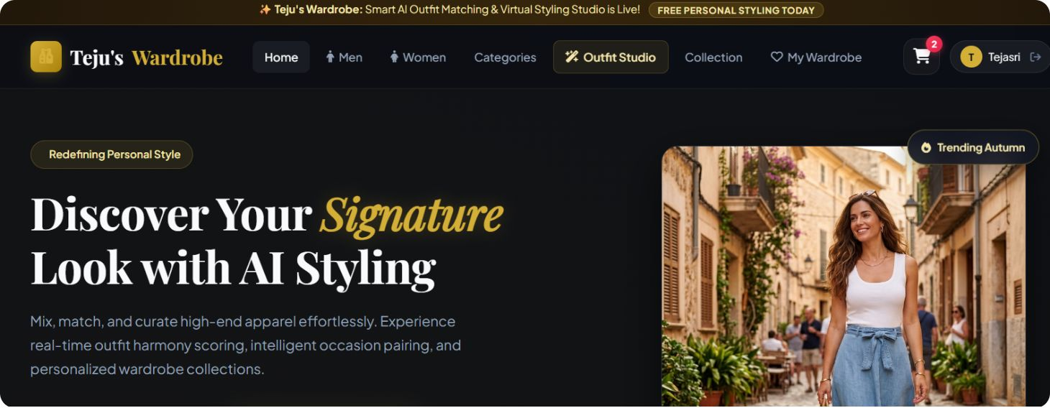
Key UI Sections (Design + Behavior)
Header & Hero
Sticky responsive nav with logo + categories + My Wardrobe, Sign In/Register.
Hero: "Discover Your Perfect Style", CTA: Explore Collection / Create Your Outfit.
Glassmorphism cards and elegant typographic hierarchy.

Slide 4
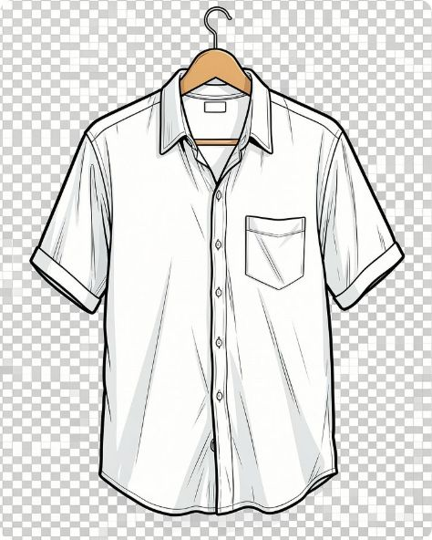
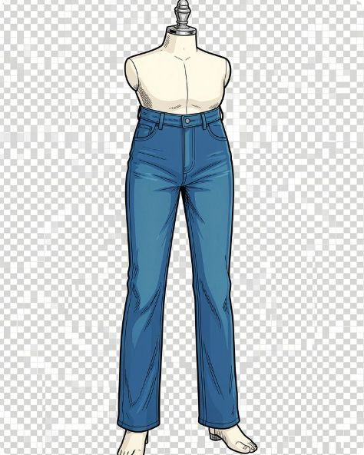
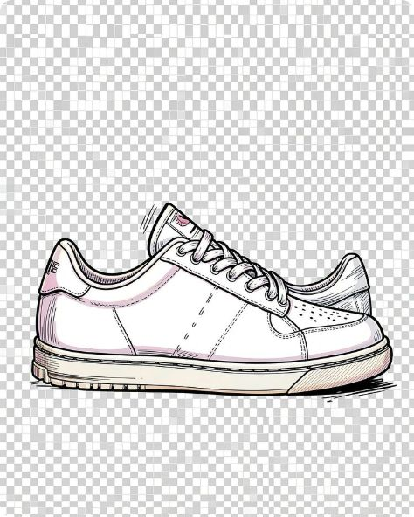
Product Grid & Selection Flow
White Casual Shirt
Blue Jeans
Selection & Interactions
$39 • Tops • White
$59 • Jeans • Blue
Each product card includes Select, Favorite, Add to Cart. Selecting highlights the card, adds it to Selected Items, and updates the Outfit Preview instantly via JavaScript (no refresh).
Selected Items panel shows thumbnails + names + Remove / Clear All.
Image click toggles selection and triggers matching engine.
Cart updates quantities and totals dynamically.
White Sneakers
$75 • Shoes • White

Slide 5
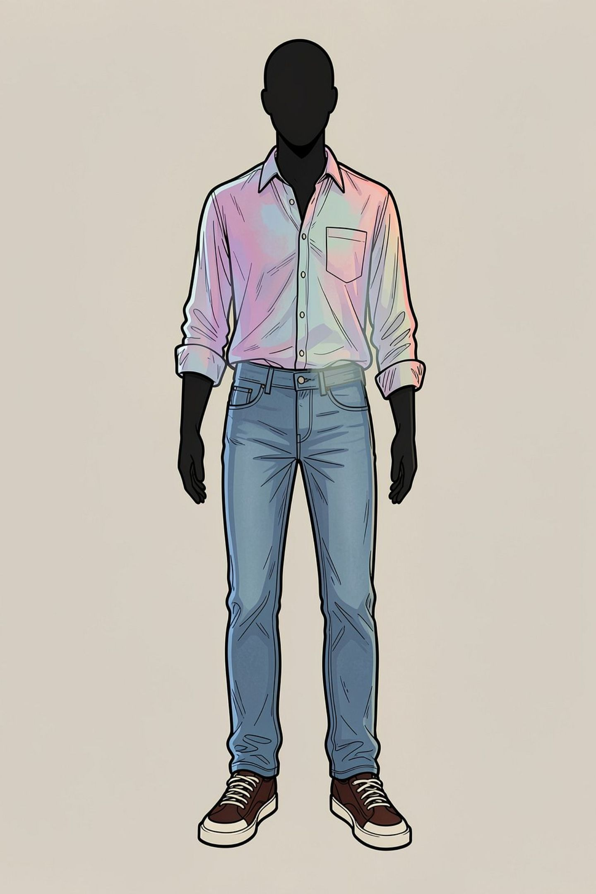
Outfit Preview & Smart Matching
Generate Outfit combines selected items into a layered mockup over a mannequin silhouette. "Find Matching Items" uses rule-based recommendations (JS heuristics) — e.g., selecting Blue Jeans suggests White Shirt, Denim Jacket, Casual Sneakers. Recommendations are interactive and can be added to the selection with one click.

Slide 6
Features — Functionality Checklist
1
2
3
4
Persistent Wardrobe
Search & Filters
Auth Demo
Cart & Checkout Mock
Search bar + filters by Category, Colour, Price, Occasion, Season, Gender with client-side filtering.
Register & Sign In forms with client-side validation and demo LocalStorage-based auth for a realistic UX.
Saved outfits, favorites, and recent selections stored in LocalStorage for cross-session persistence.
Cart with image, quantity controls, dynamic totals, remove item — all driven by JS.

Slide 7
Code & File Structure
Files
index.html — markup & structure
style.css — responsive layout, glassmorphism, animations (use #481c9eff for accents)
script.js — all selection, preview, matching, LocalStorage, auth demo, cart logic
images/ — organized by category (shirts, jeans, dresses, jackets, shoes, bags, accessories)

Slide 8
Conclusion
Teju's Wardrobe brings the shopping experience together with a polished, intuitive interface and a seamless product browsing flow. Built with a responsive front end, interactive filtering, preview, cart, and local storage features, it combines practical functionality with modern design. The result is a technical implementation that feels fast, organized, and dependable across devices. Most importantly, it delivers a smoother, more engaging experience that helps users discover and shop with confidence.

Slide 9

Thank You

